Slide 1
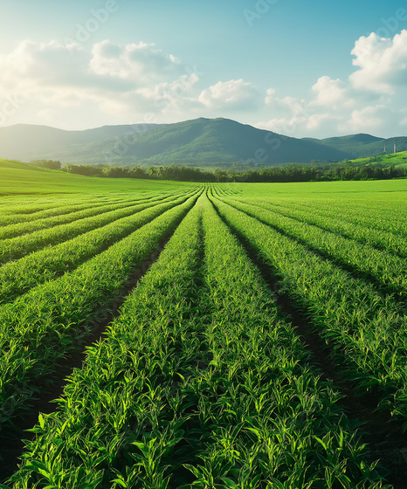
CROP and WEATHER DEPENDANT YIELD
HAADI YAKUBU

Slide 2

Compare yield performance across Wheat, Corn, and Soybeans
Identify environmental factors influencing crop yields
KEY OBJECTIVES
Recommend strategies for maximizing productivity
Recommend actions for growth and risk reduction

Slide 3
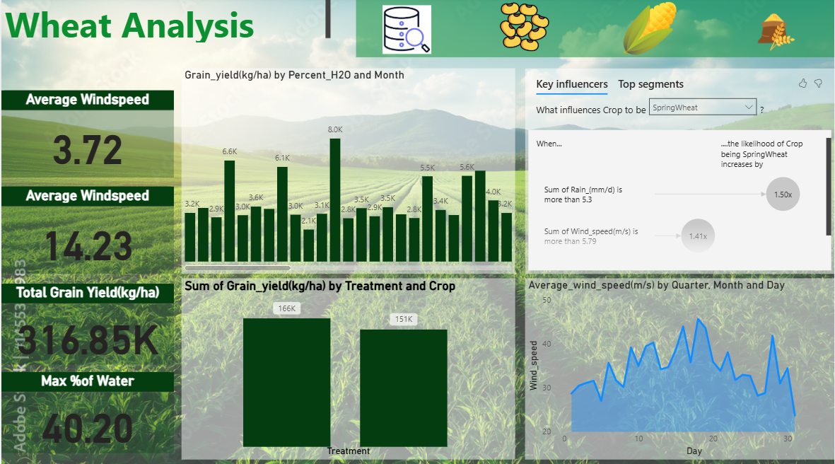
VISUALIZATIONS

Slide 4
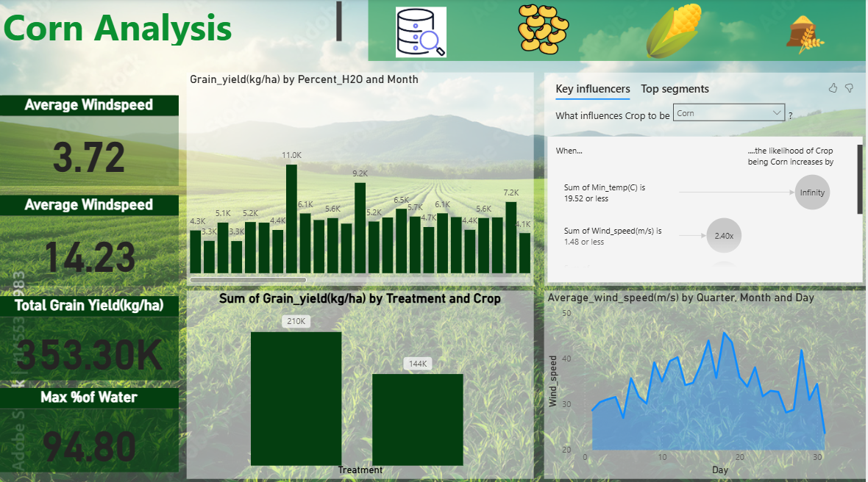

Slide 5
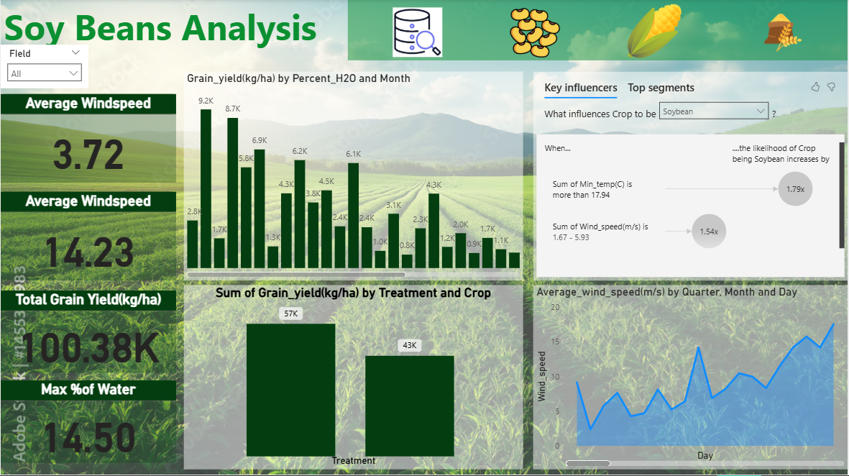

Slide 6
Key Insights​
Wheat ​
Corn
Soy Beans
Key Metrics:
Avg. Wind Speed: 3.72 m/s
Max % Water: 40.2%
Total Grain Yield: 316.85K kg/ha
Insights:
Yield peaks at 8.0K under higher %H₂O
Rainfall >5.3 mm/d and Wind >5.79 m/s increase Spring Wheat likelihood
​
Key Metrics:
Avg. Wind Speed: 3.72 m/s
Max % Water: 94.8%
Total Grain Yield: 353.30K kg/ha
Insights:
Highest yield observed 11.0K under high %H₂O
Corn thrives when Min Temp ≤19.5°C & Wind ≤1.48 m/s
Yields vary widely by treatment (210K vs 144K)
Key Metrics:
Avg. Wind Speed: 3.72 m/s
Max % Water: 14.5%
Total Grain Yield: 100.38K kg/ha
Insights:
Yield peaks at 9.2K under optimal water conditions
More likely when Min Temp >17.9°C
Wind speeds 1.67–5.93 m/s positively influence growth

Slide 7

Comparative Insights
Corn has the highest yield (353.30K kg/ha)
Soybeans have the lowest yield (100.38K kg/ha)
Wheat yield influenced by Rainfall & Wind
Corn influenced by Temperature & Wind
Soybeans by Temperature & Moderate Wind

Slide 8

Recommendation
Optimize irrigation for Corn to sustain high yields
Manage windbreaks for Wheat during high wind seasons
Plant Soybeans in warmer areas with moderate wind
Tailor crop treatment strategies per crop type

Slide 9

Thank you

